Slide 1

Greedy Algorithms, Activity Selection, Analysis
CLRS Chapter 16.1, 16.2

Slide 2
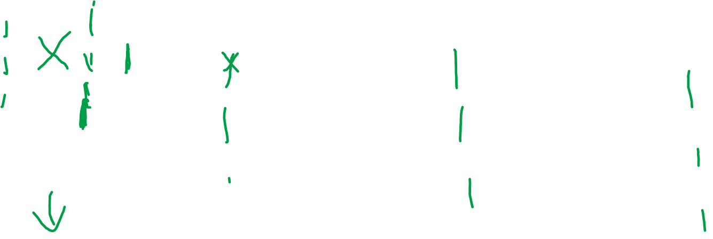
Correctness of Algorithm:
Our first choice is in the optimal solution. If not, replace first activity in the optimal solution with our first choice (earliest finish time):
Optimal solution vs. our greedy solution:
Combine to get another optimal solution:
.

Slide 3
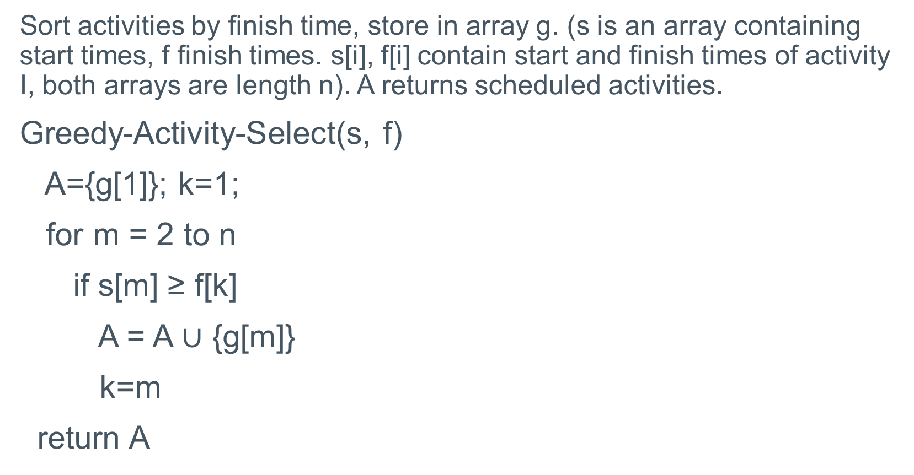
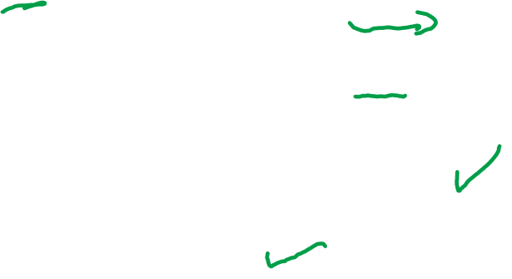
Iterative Algorithm for Activity Selection
Sort activities by finish time, store in array g. (s is an array containing start times, f finish times. s[i], f[i] contain start and finish times of activity I, both arrays are length n). A returns scheduled activities.
Greedy-Activity-Select(s, f)
A={g[1]}; k=1;
for m = 2 to n
if s[m] ≥ f[k]
A = A $∪$ {g[m]}
k=m
return A

Slide 4
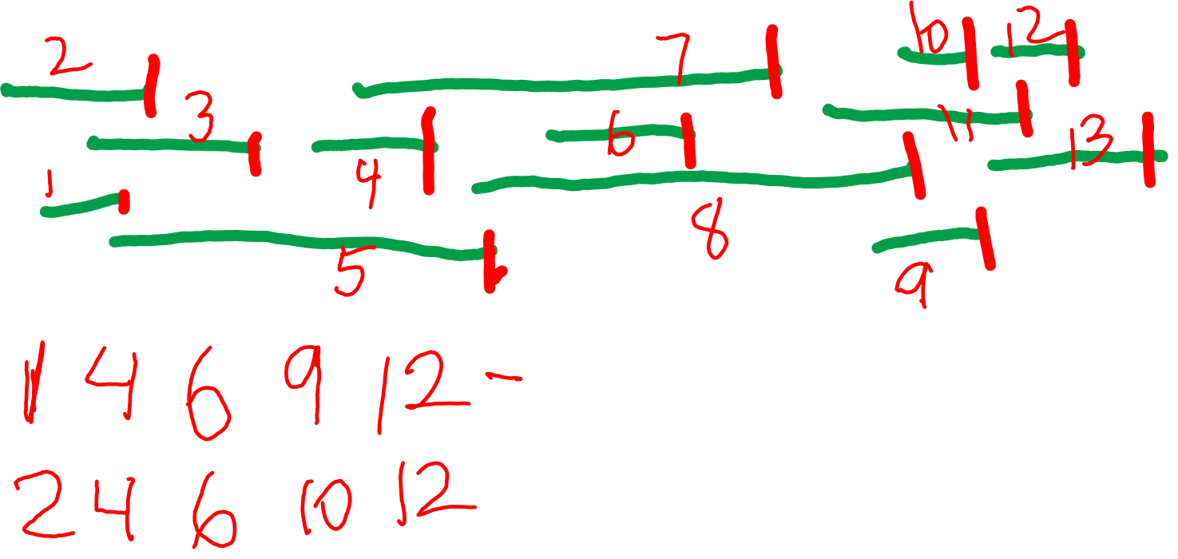
Short Trace of Activity Selection

Slide 5
Running Time of Activity Selection
We run through all activities once.
For each activity, we compare it to the last activity scheduled (to see if they are compatible) in O(1) time.
Altogether O(n) time.
If you’re sorting first, that takes O(n log n) time, altogether giving O(n log n) time.

